Slide 1

advanced machine learning project

Slide 2


Agenda ------------------ Decision tree neural network support vector machine (svm) support vector machine (svr) used database

Slide 3

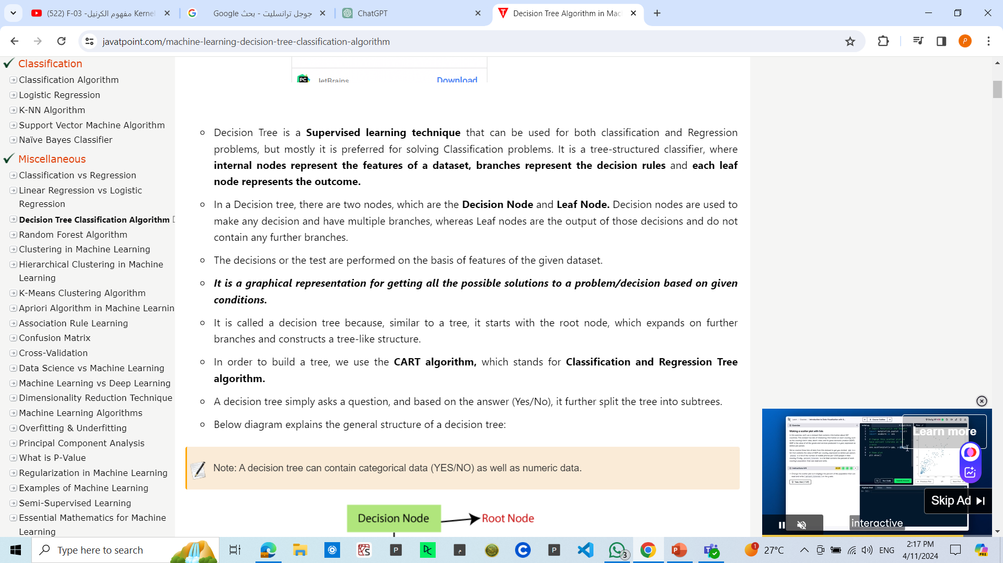
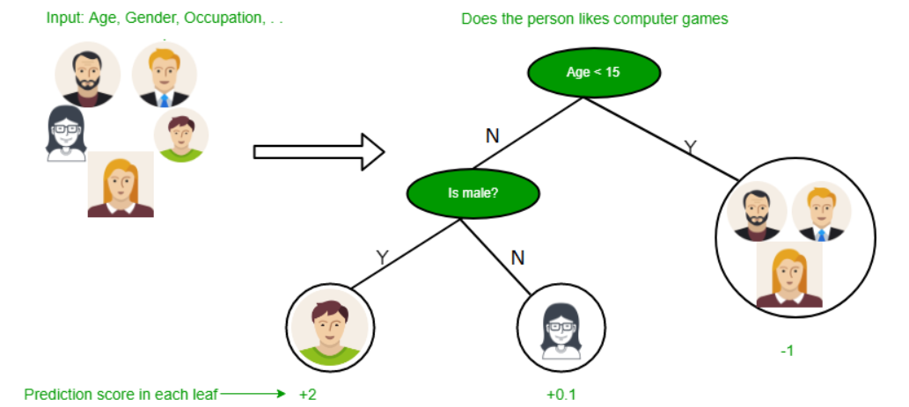
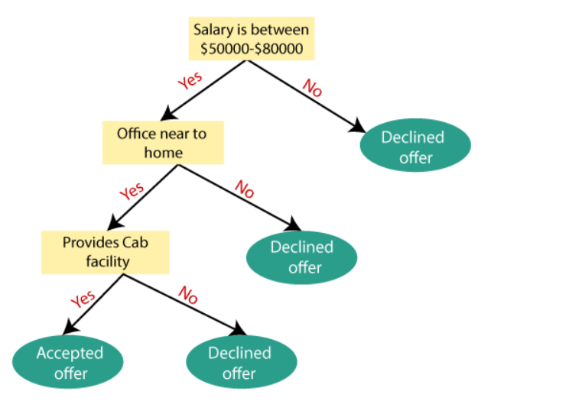
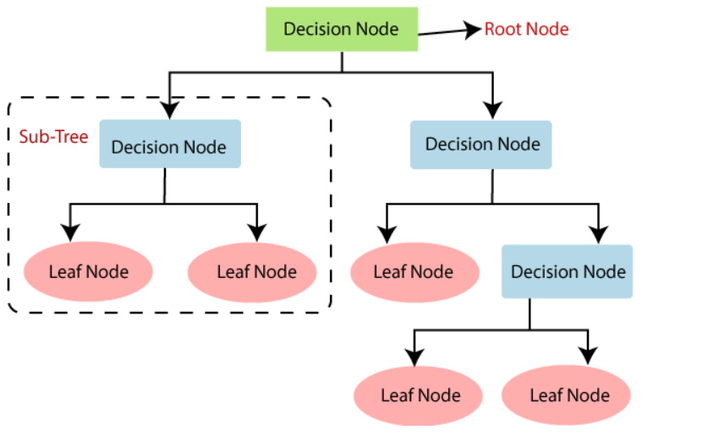
Decision tree

Slide 4

neural network

Slide 5
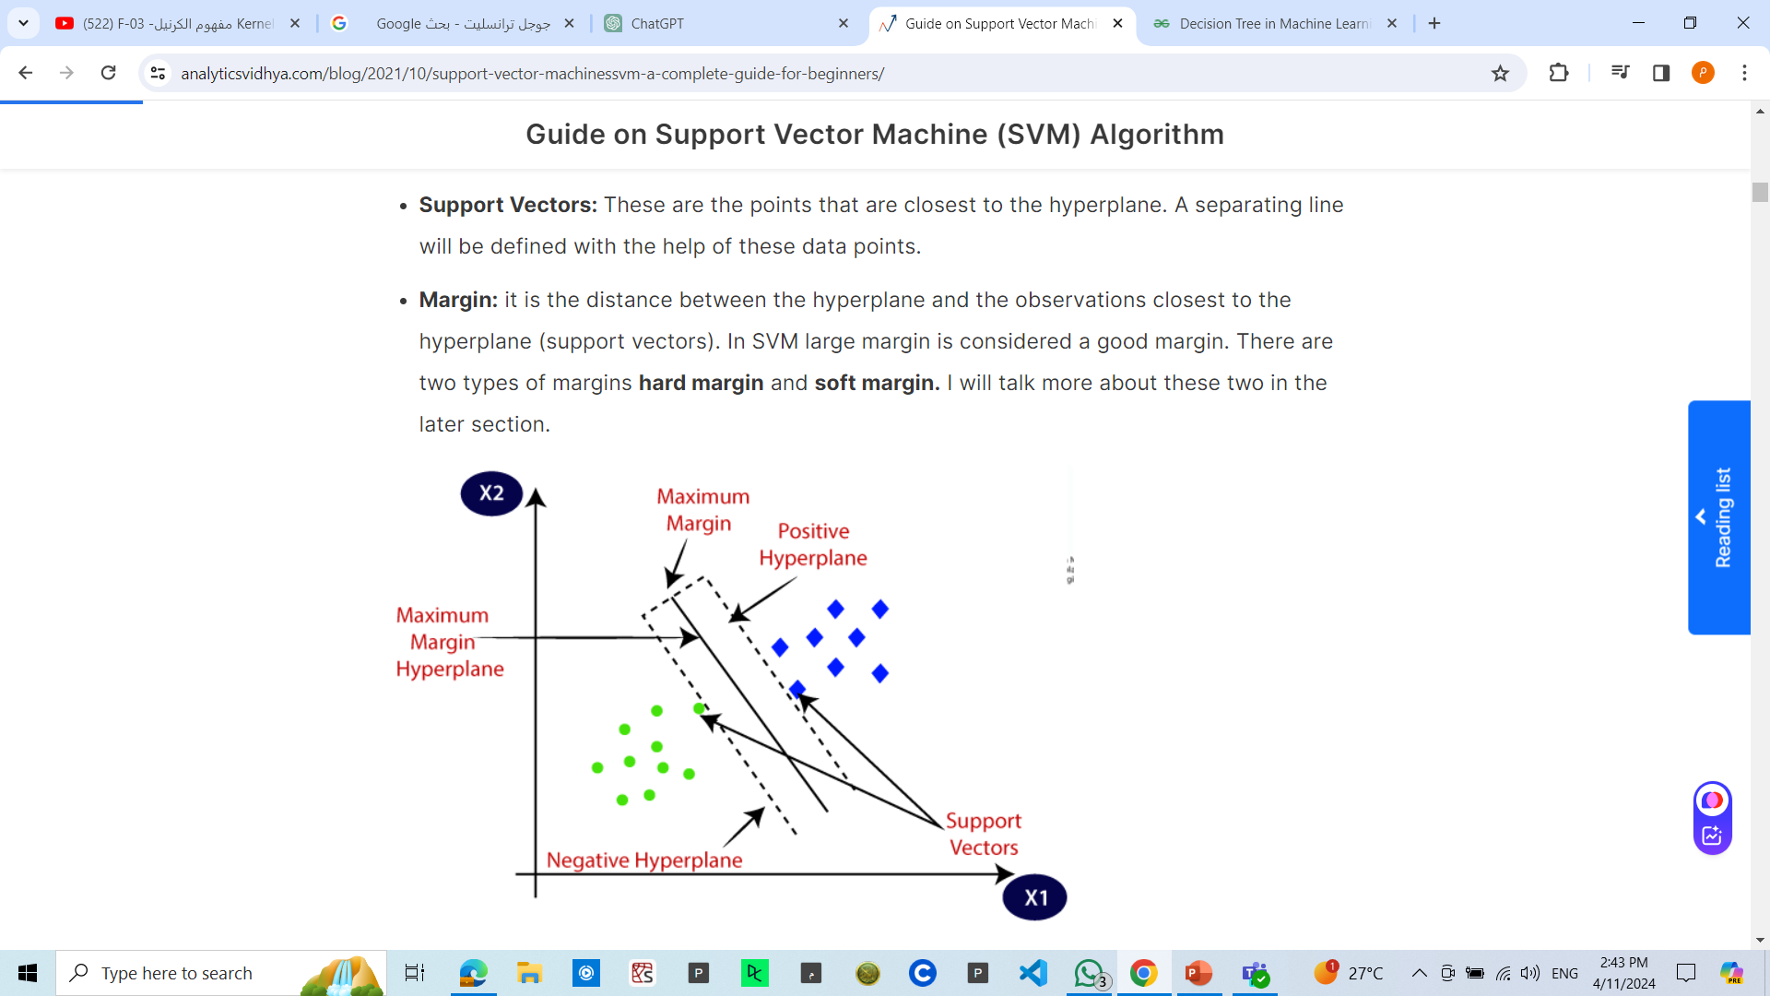
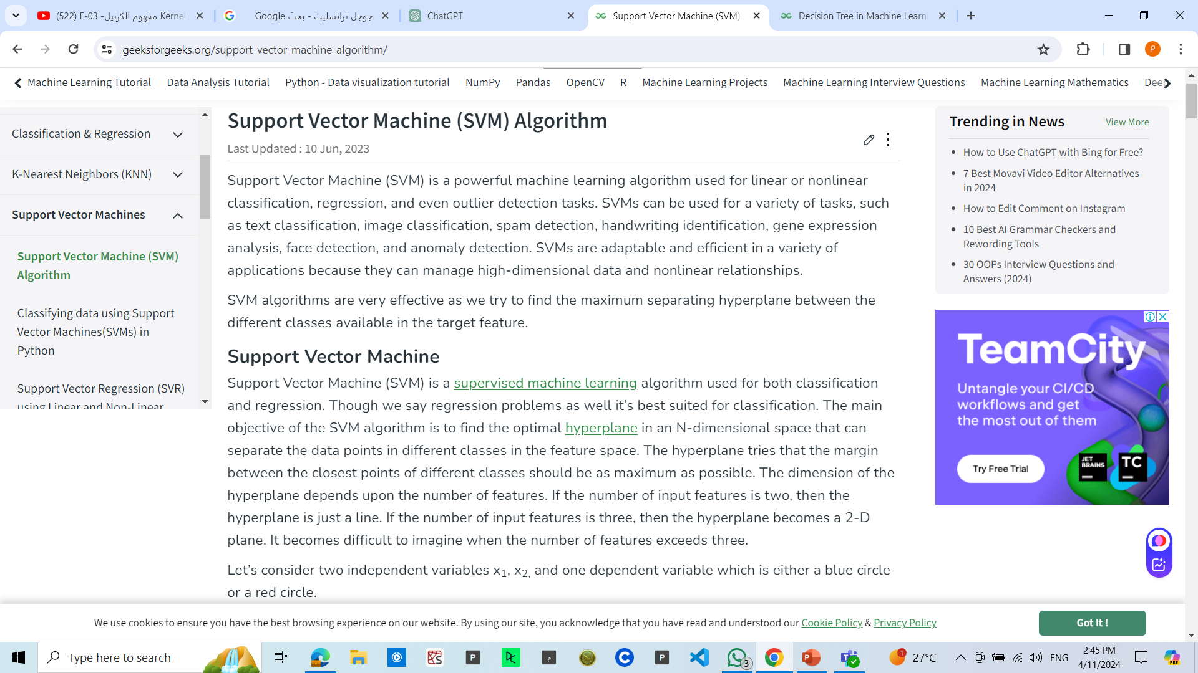
support vector machine (svm)

Slide 6
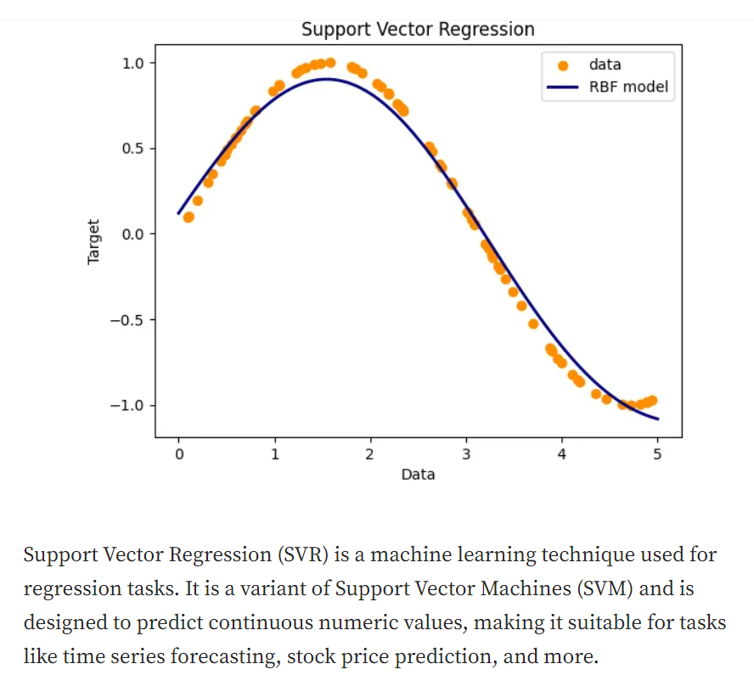
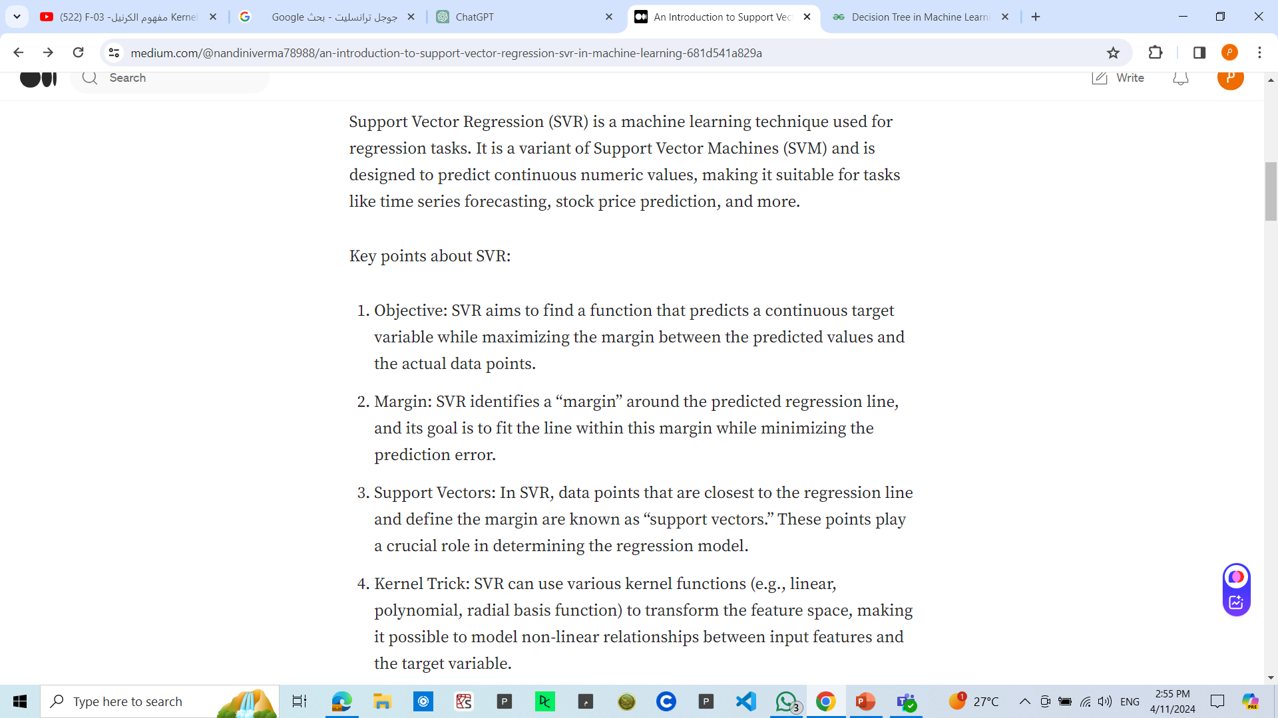
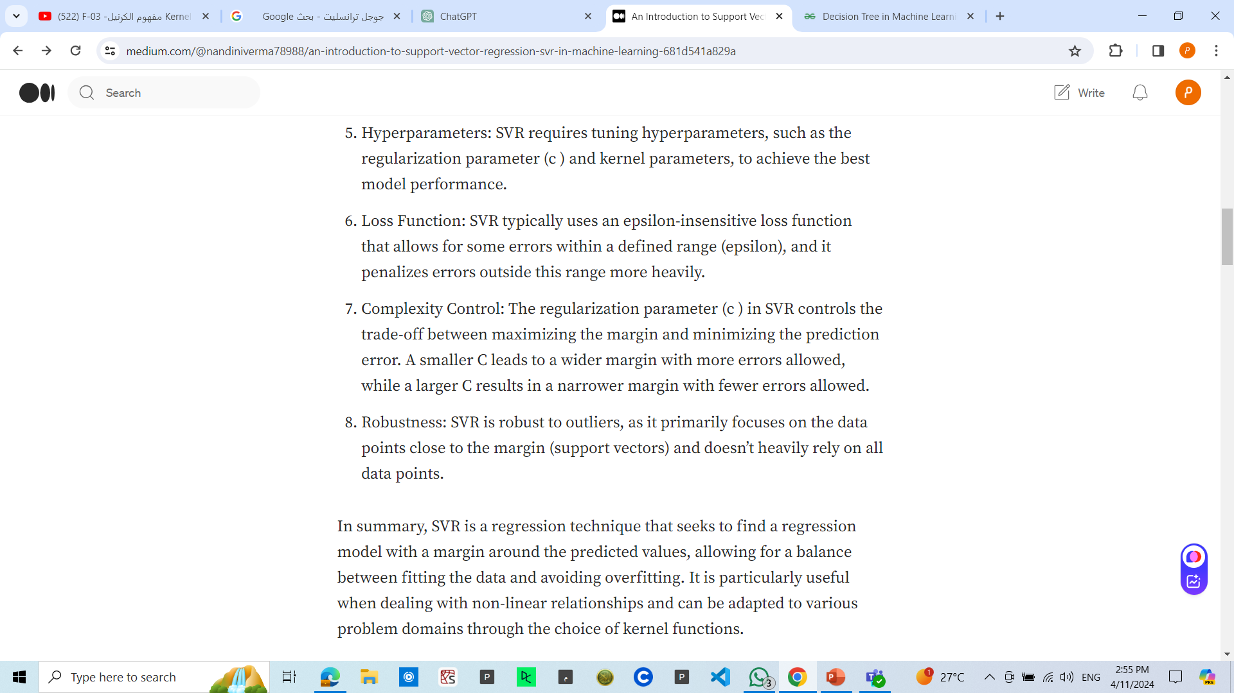
support vector machine (svr)

Slide 7

Used dataset

Slide 8
Classification using neural network

Slide 9
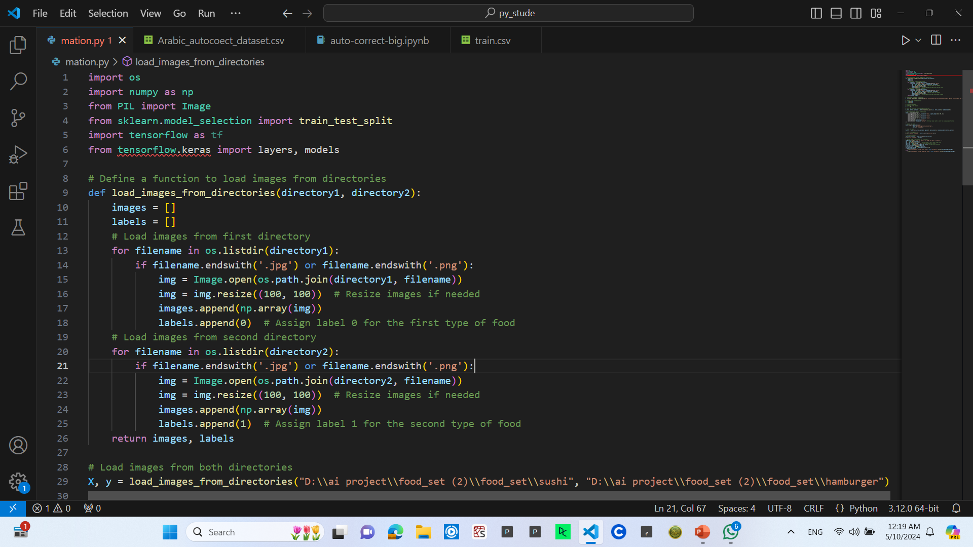
Data loading
Load images from first directory
checks if the current is an image file
opens the image file using the Image module from the Python Imaging Library (PIL)
Resize images if needed
This line converts the image data into a NumPy array and appends it to the images list
Assign label 0 for the first type of food

Slide 10
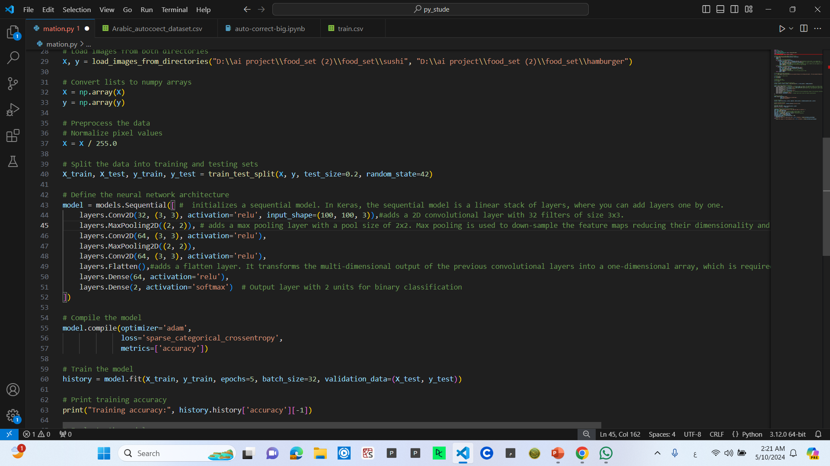
Model initialization
initializes a sequential model. In Keras, the sequential model is a linear stack of layers, where you can add layers one by one.
adds a 2D convolutional layer with 32 filters of size 3x3. The activation function used is ReLU (Rectified Linear Unit).
adds a max pooling layer with a pool size of 2x2. Max pooling is used to down-sample the feature maps, reducing their dimensionality and computational complexity.
adds a fully connected (dense) layer with 64 neurons and ReLU activation function. This layer is used to learn complex patterns in the data.

Slide 11
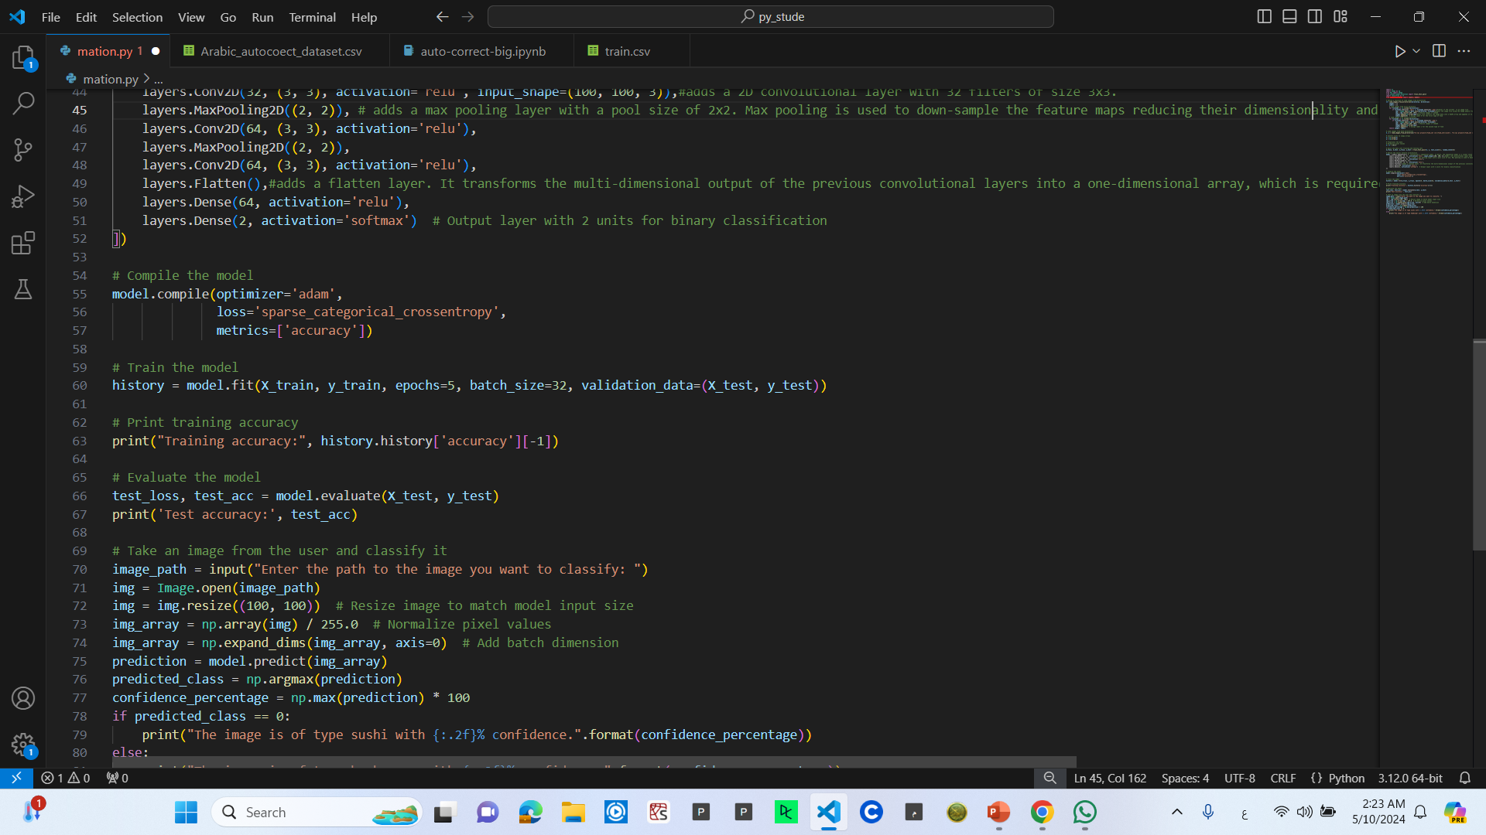
Training phase
Compiling the Model:
Configures the model for training by specifying the optimizer, loss function, and metrics to monitor.
optimizer='adam': Adam optimizer adjusts the learning rate during training.
loss='sparse_categorical_crossentropy': Loss function suitable for multi-class classification tasks.
metrics=['accuracy']: Metric to monitor durinTraining the Model:
Trains the model on the training data for a specified number of epochs.
epochs=5: Number of times the entire dataset is passed forward and backward through the network.
batch_size=32: Number of samples processed together before updating the model's parameters.
Model performance is evaluated on the validation data after each epoch.
Printing Training Accuracy:
Prints the accuracy achieved on the training data after training.
Retrieves training accuracy from the history object returned by fit().
Evaluating the Model:
Evaluates the model's performance on the test data.
Returns test loss and test accuracy.
Test accuracy indicates how well the model generalizes to unseen data.g training.

Slide 12
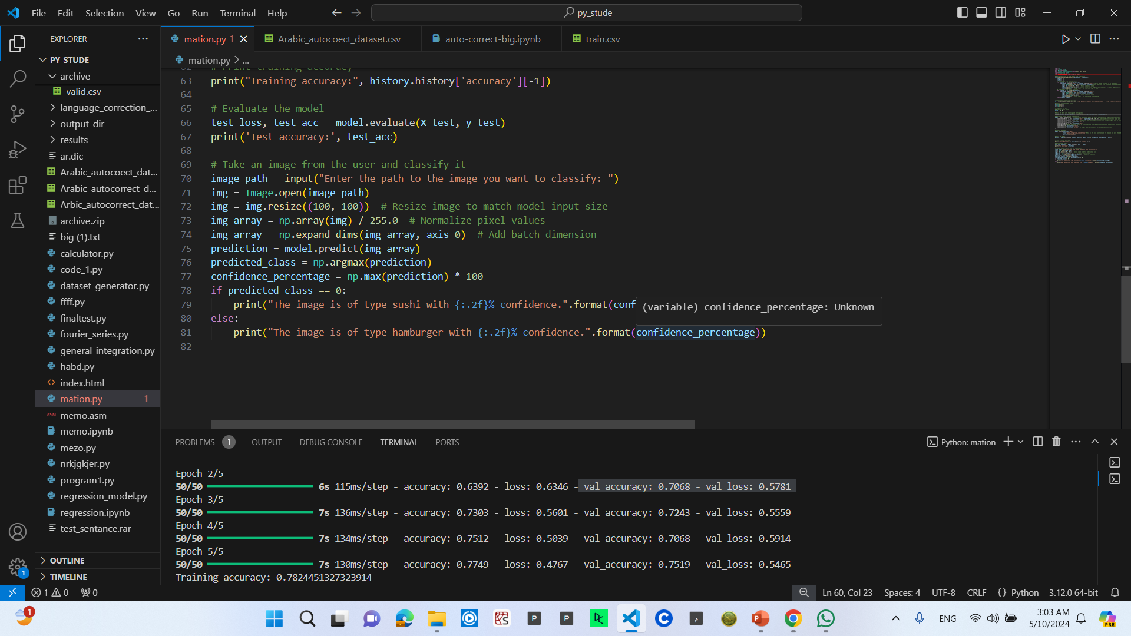
Using model
Prompts the user to input the path to the image file they want to classify.
Loads the image from the specified path using PIL (Image.open()).
Resizes the image to a size of 100x100 pixels, which matches the input size expected by the model.
Converts the image to a NumPy array (img_array).
Normalizes the pixel values to be between 0 and 1 by dividing by 255.0.
Adds a batch dimension to the image array using np.expand_dims() to match the batch format expected by the model.
Uses the trained model (model) to predict the class probabilities for the input image (img_array)4
Checks the predicted class and prints the corresponding classification result along with the confidence percentage.

Slide 13
Classification using neural Decision tree

Slide 14
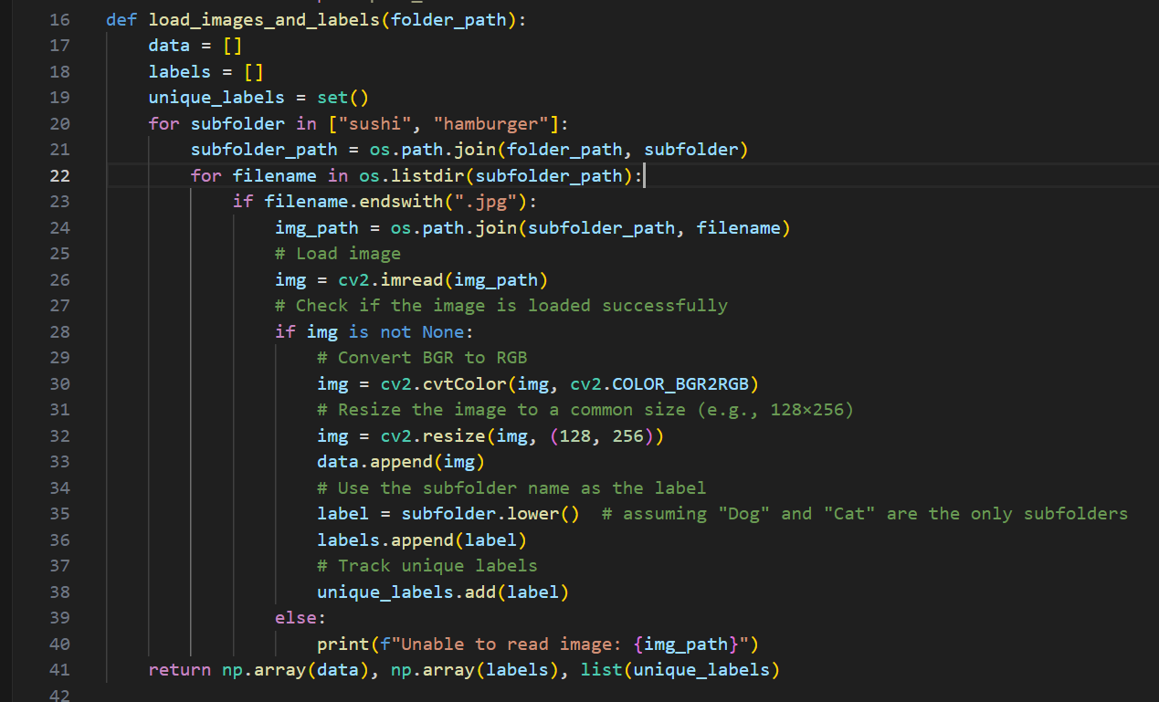
Data loading
Initialization:
Initializes three lists: data to store image data, labels to store corresponding labels, and unique_labels to keep track of unique labels encountered.
Iterating Through Subfolders:
Iterates through the subfolders named "sushi" and "hamburger" within the specified folder_path.
For each subfolder:
Constructs the full path to the subfolder.
Iterates through the files within the subfolder.
Loading and Processing Images:
Checks if the file has a ".jpg" extension.
If the file is an image:
Reads the image using OpenCV's cv2.imread() function.
Converts the image from BGR to RGB color space using cv2.cvtColor() since OpenCV reads images in BGR format by default.
Resizes the image to a common size, such as 128x256 pixels, using cv2.resize().
Appends the resized image data to the data list.
Extracts the label from the subfolder name and converts it to lowercase, assuming that the subfolder names "sushi" and "hamburger" represent the class labels.
Appends the label to the labels list.
Tracks unique labels encountered in the unique_labels set.

Slide 15
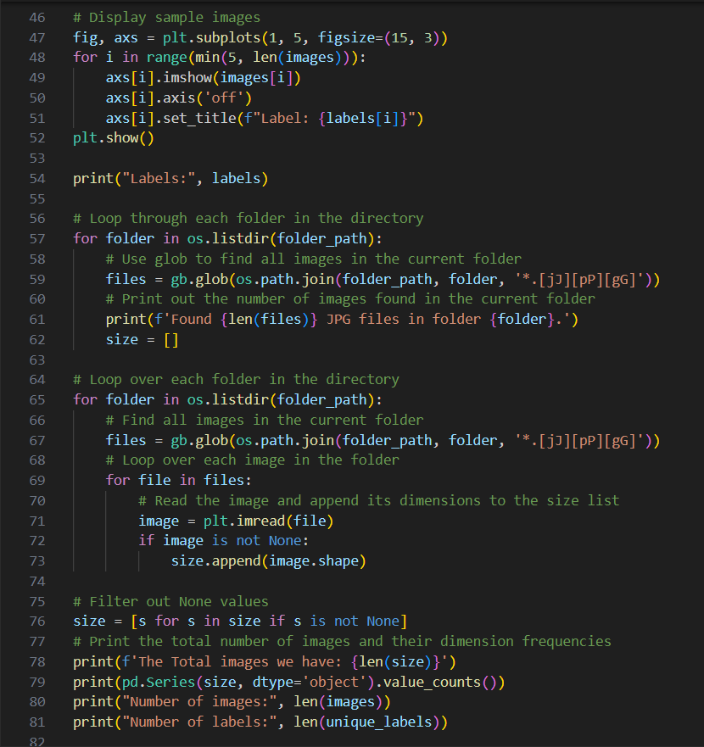
Reading image
1. Looping Through Folders and Counting Images:
This loop iterates over each folder within the specified folder_path.
It uses the glob module to find all JPEG (".jpg" or ".JPG") image files (*.[jJ][pP][gG]) within each folder.
It prints out the number of JPEG files found in each folder.
2. Iterating Through Images and Collecting Dimensions:
This loop iterates over each folder within the folder_path again.
It finds all JPEG image files in each folder using glob.
For each image file, it reads the image using plt.imread() from Matplotlib.
If the image is successfully loaded (image is not None), it appends its dimensions (image.shape) to the size list.
3. Filtering and Displaying Image Statistics:
It filters out any None values from the size list.
It prints the total number of images found and their dimension frequencies using pd.Series(value_counts()) from Pandas.
Finally, it prints the number of images and labels. However, images and unique_labels variables are not defined within this snippet, so it's unclear what they refer to.

Slide 16
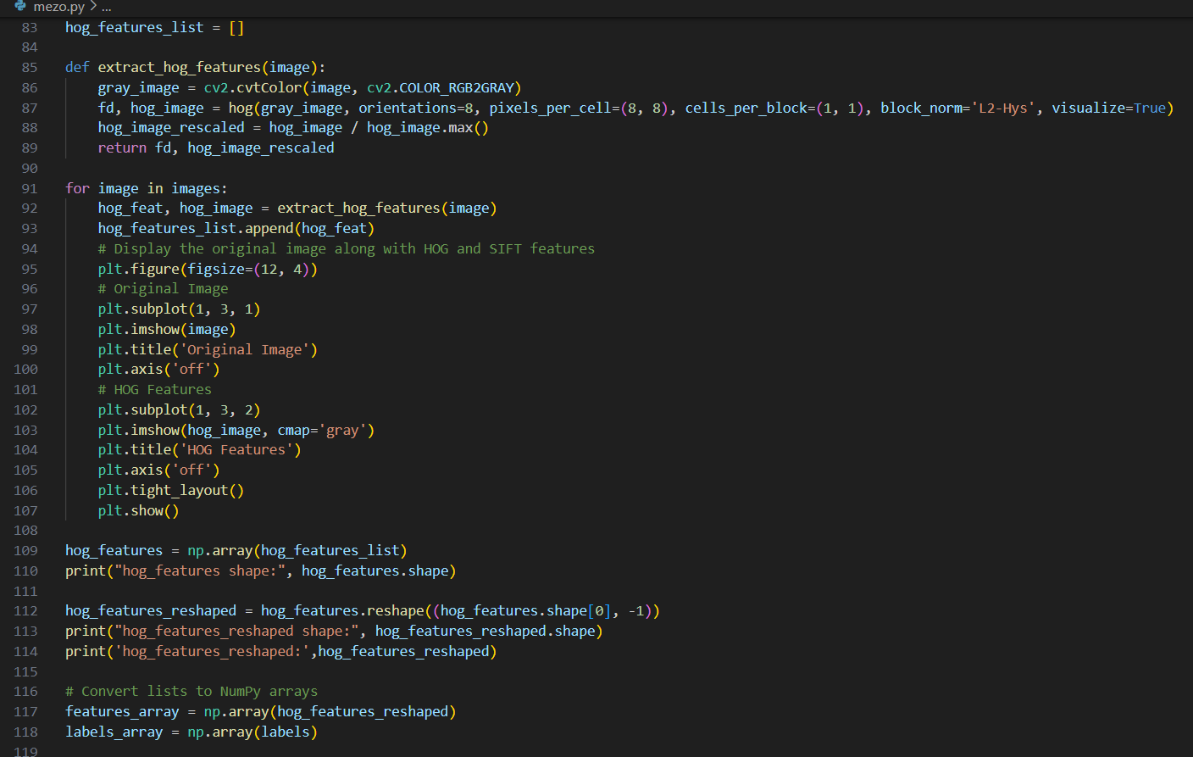
Features extraction
Initialization:
A list named hog_features_list is initialized to store the extracted HOG features.
Feature Extraction Loop:
A loop iterates through each image in the images list.
For each image, the extract_hog_features function is called to compute the HOG features.
The computed HOG features are appended to the hog_features_list.
The original image and its corresponding HOG feature representation are displayed using Matplotlib's plt.subplot() and plt.imshow() functions.
Conversion to NumPy Arrays:
The hog_features_list is converted to a NumPy array named hog_features.
The shape of hog_features is printed to show the dimensions of the HOG feature matrix.
The hog_features array is reshaped using reshape() to flatten it into a 2D array.
The shape of the reshaped hog_features array is printed.
Both hog_features and labels are converted to NumPy arrays.

Slide 17
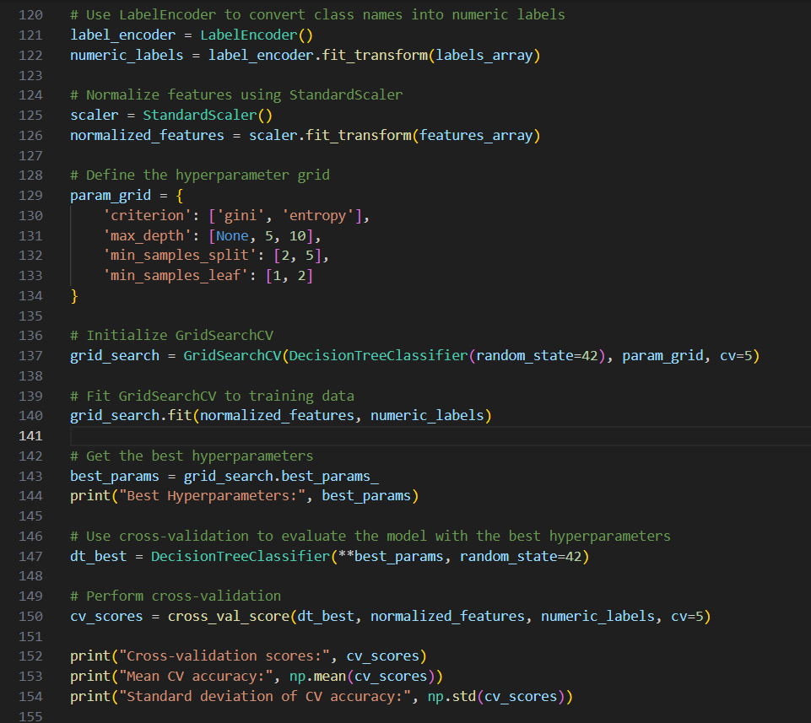
Model preparing
Label Encoding:
It uses LabelEncoder from Scikit-learn to convert class names (labels) into numeric labels.
The fit_transform() method of LabelEncoder is applied to labels_array, resulting in numeric_labels.
Feature Normalization:
It normalizes the features using StandardScaler from Scikit-learn.
The fit_transform() method of StandardScaler is applied to features_array, resulting in normalized_features.
Hyperparameter Grid Definition:
It defines a grid of hyperparameters for the decision tree classifier.
The grid contains different values for hyperparameters such as criterion, max_depth, min_samples_split, and min_samples_leaf.
Grid Search for Hyperparameter Tuning:
It initializes GridSearchCV from Scikit-learn with the decision tree classifier, the hyperparameter grid, and 5-fold cross-validation (cv=5).
The fit() method of GridSearchCV is called with the normalized features (normalized_features) and numeric labels (numeric_labels) to find the best hyperparameters.
Best Hyperparameters Retrieval:
It retrieves the best hyperparameters (best_params) found by grid search.
Model Evaluation with Cross-Validation:
It initializes a decision tree classifier (dt_best) with the best hyperparameters.
It performs cross-validation (cross_val_score()) with 5 folds on the normalized features and numeric labels to evaluate the model's performance.
It prints the cross-validation scores, mean accuracy, and standard deviation of accuracy.

Slide 18
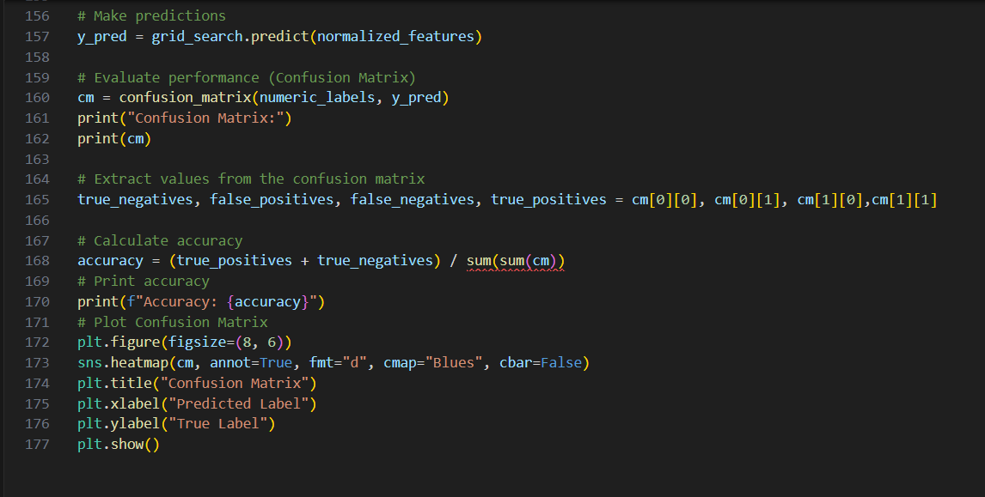
Using model
Making Predictions:
It uses the trained grid_search object (which includes the best-performing decision tree classifier) to predict the labels for the normalized features (normalized_features).
The predicted labels are stored in the y_pred variable.
Confusion Matrix:
It computes the confusion matrix (cm) using confusion_matrix from Scikit-learn.
The confusion matrix is a tabular representation of actual versus predicted class labels.
Confusion Matrix Analysis:
It extracts values from the confusion matrix, namely true negatives, false positives, false negatives, and true positives, which are used to calculate accuracy.
Accuracy Calculation:
It calculates accuracy using the formula (true_positives + true_negatives) / total.
The accuracy value is printed to assess the performance of the model.
Confusion Matrix Visualization:
It visualizes the confusion matrix using heatmap from Seaborn.
The heatmap provides a graphical representation of the confusion matrix, making it easier to interpret.

Slide 19

Thank You!
someone@example.com

